Slide 1
CBP’s Trade Transformation
CBP Initiatives for 21st Century Trade
November 2012

Slide 2

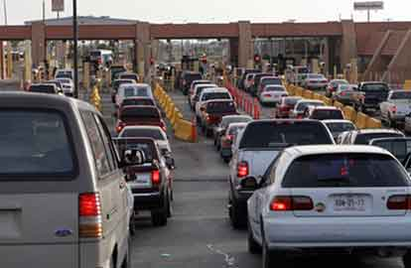
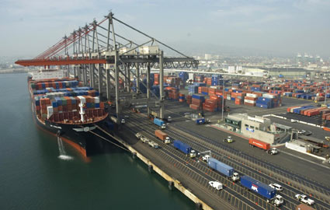
A Day at the U.S. Border
CBP protects more than:
5,000 miles of border with Canada
1,900 miles of border with Mexico
95,000 miles of shoreline
329 Ports of Entry
20 Border Patrol Sectors
37 Permanent Checkpoints
1 Million Passengers Daily
250 Thousand Vehicles Daily
50 Thousand Truck, Rail and
Sea Containers Daily
Processes

Slide 3
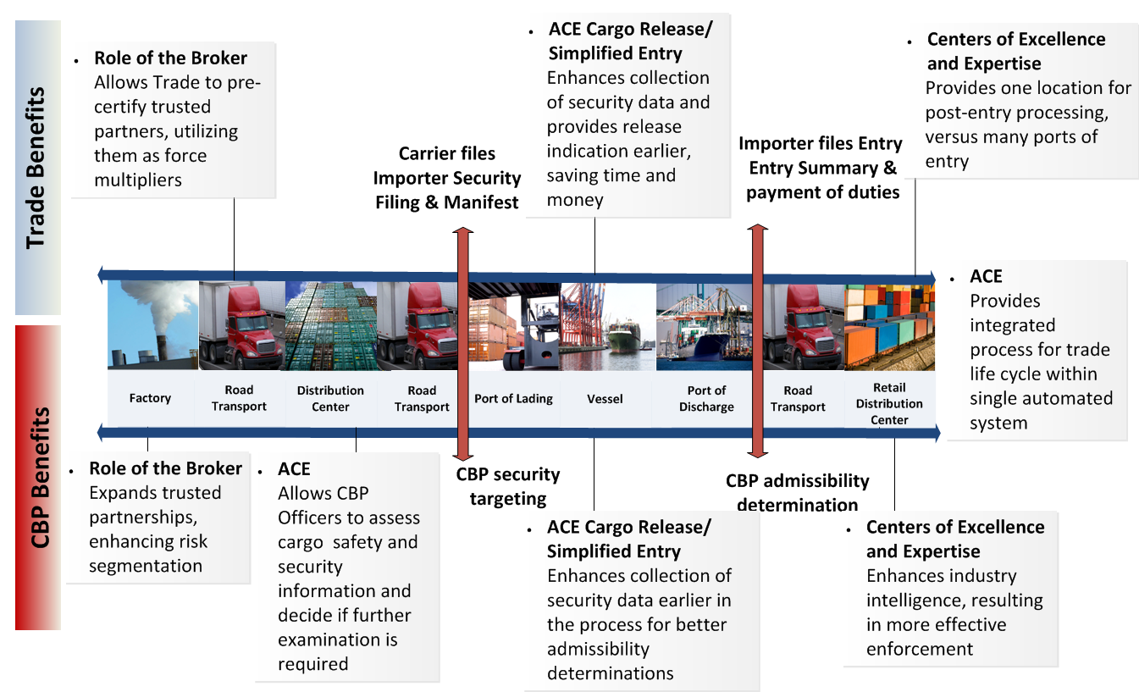
Transforming the Cargo Clearance Process

Slide 4
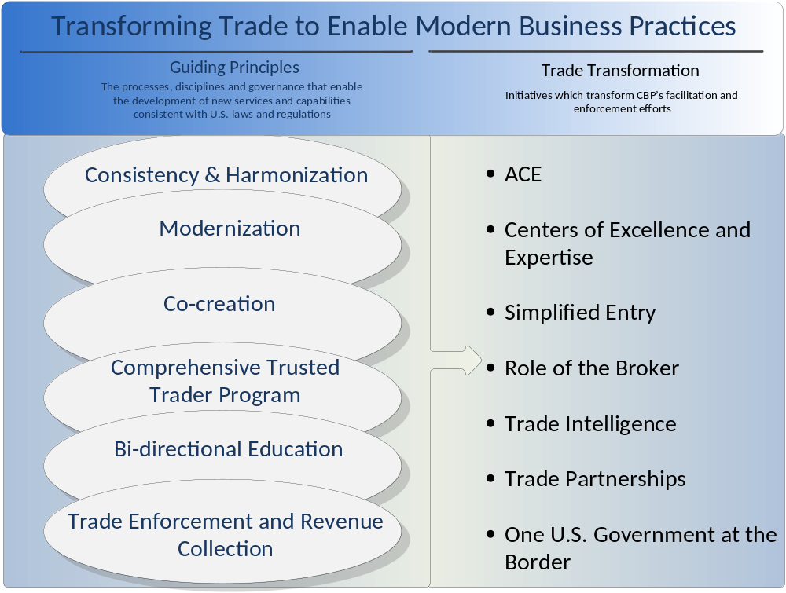
Trade Transformation Initiatives

Slide 5
ACE
Overview
  CBP’s commercial trade processing system and the backbone for speeding the flow of legitimate shipments.
  Forms the “single window” through which the international trade community will electronically provide all information needed by federal agencies for the import and export of cargo.
Future Plans
  Work underway with DHS to develop detailed plans for completion of ACE program priorities expeditiously and in cost effective manner.
  CBP re-orienting development team and processes to an Agile development methodology, in close collaboration with DHS.
  Agile methodology – Allows for quicker delivery of capabilities by focusing on smaller pieces of functionality that build upon one another over time.
  Leveraging expertise from across CBP, DHS and partner organizations.

Slide 6
ACE Capabilities
 | Pre-Arrival | Arrival | Post Release | Export | Finance
Description of Modernized End State | Modernizes “pipeline” to deliver data ACE funding for Automated Targeting System (ATS) since 2001 ACE data feeds ATS More info available; less inspection required | Enhances data available for CBP & PGA to assess safety, security, compliance Enables speedier release of legitimate imported cargo into the U.S. commerce “Single window” for trade and government agencies involved in importing / exporting | Modernizes data requirements to validate compliance with U.S. trade laws Brings the full international trade business process into a single system | Supports President’s National Export Initiative (NEI) with single exports processing platform Enhances targeting capability for exports Single system for imports and exports | Modernizes financial processes for CBP which are nearly 30 years old Streamlines payment mechanisms
Delivered Capabilities | Screening Capabilities Truck Manifest Rail and Sea Manifest | Cargo Release/Simplified Entry PGA Interoperability | ACE Accounts and Reports Entry Summary Filing AD/CVD Courtesy Notice Report Entry Summary Corrections Document Image System Responses to CBP Forms | Export Manifest (via Document Image System) | Monthly Statement Payment
Impact of Delivered Capabilities | Better ID of high risk shipments enabling government to focus resources 33% faster processing with ACE electronic manifest Automation of paper process 100% of rail and sea manifests in ACE 100% of in-bond data for rail, ocean and truck shipments in ACE Savings of $39.5M/year for CBP processing (2011 independent study) | Data provided earlier in transportation chain Risks pinpointed with increasing efficiencies Previously unavailable data now provided from ACE to Government partners Automation of paper processes As of October 31, 2012, approximately 30,000 Simplified Entries submitted | >60,000 ACE reports run per month by CBP, govt partner and trade community users Automated Census overrides and warnings Courier cost reductions by trade community as high as 43% reported from paperless filings in ACE Automation of report CBP was required to print and post with estimated savings to CBP of $3.4M/year Automation of paper processes 18.73% of entry summaries filed in ACE | Electronic submission of ocean carrier export manifests Link to targeting for enhanced screening of export cargo Estimate from one carrier of $20K savings per month in printing and courier costs | Monthly, interest-free payments for trade community 68% of duties and fees paid via ACE Improvement in collections, accounts receivable and financial reporting

Slide 7

ACS to ACE
Funding - at some point CBP has to begin to turn off ACS and fully commit to ACE
It’s a funding issue - Congress measures progress by # of entries filed in ACE vs. ACS
It’s a chicken and the egg sort of debate
Do I shut off ACS to force more ACE transactions to get more funding?
Or do I get ACE fully functional first? But how do I get fully functional w/out funding?
Trade – be fully engaged w/ CBP & Congress about when the transition will happen
CBP will very soon be turning off ACS/ABI for type 1, 2 and 11 entries
Might not be today, but will be soon and you need to be ready
Assess your challenges and your broker’s challenges in transitioning to ACE
Are you or they ACE ready? Do you/they have an ACE transition plan?
Liberty International Inc. www.libertyint.com

Slide 8
ACE Cargo Release/Simplified Entry
Overview
  Cargo Release/Simplified Entry offers a new approach to the entry process which provides for earlier entry filing with fewer required data elements. This initiative reduces transaction costs, enhances cargo security, and streamlines the release of goods.
Future Plans
  Pilot began in May at three ports.
    Pilot expanded to 10 additional ports in August/September.
    CBP expanding the pilot to Anchorage, Memphis and Detroit in early November.
  CBP is in the process of on-boarding 11 additional pilot participants, for a total of 20.
  CBP is exploring options to add new functionality and modes of transportation.

Slide 9
Simplified Entry
The basic tenets of SE
The most significant changes in the entire TT effort
The most beneficial to the trade at large
  Transmit fewer data elements
  Party that owns the data transmits the data
  There’s no transmission of duplicative data
  You can update the data up until arrival
Liberty International Inc. www.libertyint.com

Slide 10
Simplified Entry
Earlier Info About Release Status
Release info as early as possible in the process
SE’s biggest benefit to the trade - adds a measure of predictability to the supply chain
Tremendous value in knowing in advance whether there will be an exam on my cargo
I can plan - prepare folks all the way down the supply chain
Key theme with simplified processing – compliance piece can happen later
Trade compliance doesn’t need to delay delivery of the cargo
Really important to the trade that SE expand to other modes
PGA support of SE needs to expand –getting the PGA’s on board
Liberty International Inc. www.libertyint.com

Slide 11
Centers of Excellence and Expertise
Overview
  Aligns CBP trade processing along industry sectors.
  Two Centers established October 2011.
      Electronics Center (Long Beach, CA).
      Pharmaceutical Center (New York, NY).
  Two New Centers established in September 2012.
      Automotive & Aerospace (Detroit, MI).
      Petroleum, Natural Gas & Minerals (Houston, TX).
Federal Register Notice Published on August 29th
Future Plans
  Five More Centers to be Established in FY 2013: Agriculture & Prepared Products; Base Metals & Machinery; Consumer Products & Mass Merchandising; Industrial & Manufacturing Materials; and Textiles, Wearing Apparel & Footwear.

Slide 12
Centers of Excellence
C’s are on a volunteer basis – trusted traders first – limited staffing initially
For everyone else centers will be a solid resource for information
The foundation of a consistent application of the rules of the game
Staffing will be key to the Centers’ success – CBP’s to get the right people in the right location - or since it’s virtual – at least assigned to the right location
Is the “C” better than current state? Depends on my current relationship w/ CBP
Clear communication about what happens in the centers – see chart
CBP has clearly communicated that their intent is to move to account based processing in the future – eventually everyone will work inside this model – the scope will expand incrementally
Important to consider how you’ll fit into this model and what it means for your business. How can you leverage it to your advantage and how will you manage your relationship with CBP through your broker in the future?
Liberty International Inc. www.libertyint.com

Slide 13
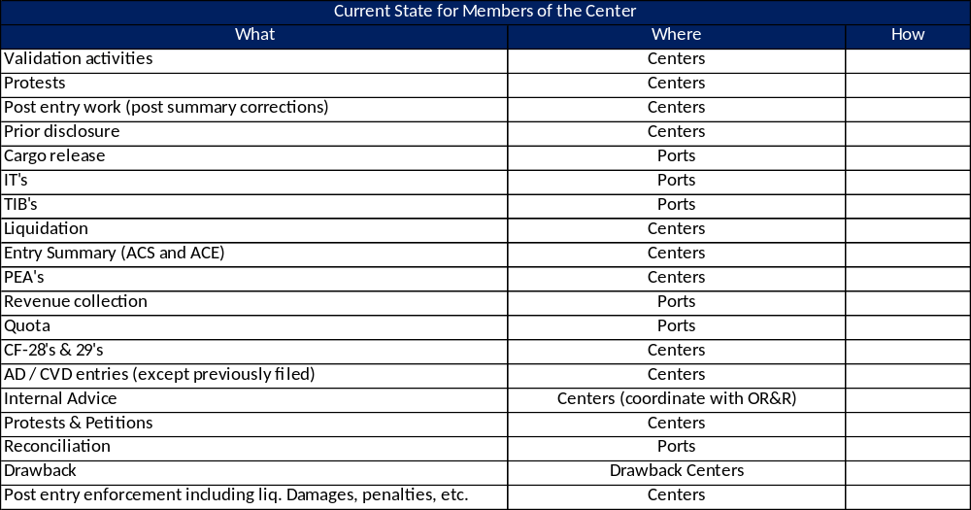
Centers
Roles & Responsibilities
Liberty International Inc. www.libertyint.com

Slide 14
Role of the Broker
Overview
  The purpose of the Role of the Broker initiative is to meaningfully transform the relationship between the customs broker and CBP. This initiative recognizes broker’s role as a communicator and force multiplier to increase compliance, especially for small- and medium-sized importers.
  In summer 2012, CBP conducted 30 roundtables with local broker groups and hosted 6 webinars to garner feedback on the Part 111 overhaul. Nearly 1,100 individuals attended the roundtables nationwide, and webinars averaged 350 participants.
  CBP received critical feedback on three primary issues: broker permitting, continuing education, and establishing bona fides.
Future Plans
  Formulate policy decisions and potential regulatory alternatives based on the feedback from the roundtables and webinars. CBP will be working both internally and externally to answer: Does CBP need to seek statutory changes? What should be regulatory? What should be in guidance? How do we acknowledge and reward the best practices of our highly compliant licensed customs brokers?
  CBP will then begin drafting a Notice of Proposed Rulemaking and economic analysis; review existing policies to determine what the agency can do without regulatory amendments.

Slide 15
Role of the Broker
ISA pre-certification – good opportunity for SME’s to join a trade compliance program with the help of your broker
When rolled out, leverage your broker to help you get ready
Trusted trader programs give real measurable advantages especially green lane status
5106 changes and POA changes – big picture CBP wants you to know who you are working with
Know who’s filing entries under your IOR# and select them carefully
Plug for ACE - identity theft – ACE portal reports – be as careful about your corporate identity as you are about your personal info – is someone bringing shipments in under your IOR#?
For licensed brokers – continuing education is important to CBP
There may be a continuing education requirement in the future to maintain your license
Stay in the conversation to be sure you get the result that you want
Make sure the program is accessible and that there are low cost or no cost education options available to you under the new program
Liberty International Inc. www.libertyint.com

Slide 16
Trade Partnerships
  Overview
    Developed project scope and guidelines to investigate the feasibility of incorporating the Importer Self Assessment (ISA) and the Customs-Trade Partnership Against Terrorism (C-TPAT) into a trusted trader program.
    Began facilitating sessions with stakeholders on how to drive up participation in ISA partnership program.
  Future Plans
    To set the stage for a Trusted Trader partnership program which merges the key benefits of current programs, along with new ones, for a robust program for the Trade.

Slide 17
Trusted Trader
Trusted trader solutions must work for SME’s
Many importers make conscious effort to be compliant
They do it with very limited resources
How do we get you onto the grid?
How do we get you into the green lane or as close to the green lane as possible without unreasonably burdening you and your business with complex trusted trader program management
A comprehensive trusted trader program is great if:
  menu that folks can choose from (eg CTPAT for exports is not mandatory for CTPAT import certification)
  voluntary
  there’s no duplication across the programs (supplier survey for one piece of the program can carry over into the others)
Liberty International Inc. www.libertyint.com

Slide 18
One U.S. Government at the Border
  Overview
    The One U.S. Government at the Border initiative furthers CBP’s efforts to coordinate with federal agencies, the trade community, and foreign governments to better define risks through increased automation and information sharing, and interagency partnership programs. Includes the Beyond the Border Initiative.
    On September 21, 2012, the Border Interagency Executive Council (BIEC) held an Import Safety Roundtable to highlight significant achievements in interagency collaboration since the 2010 Import Safety Conference.
  Future Plans
    Deploy the PGA Message Set which enables the trade to have a ‘single automated window’ for data submission required by all federal agencies during the cargo importation and review process.
    Expand system to system data exchanges to additional PGAs allowing for sharing of information in an automated manner for the release of imported goods, targeting and risk analysis.

Slide 19
Trade Intelligence
  Overview
    Virtually places individuals representing the industry sector assigned to work with Center of Excellence and Expertise (CEE) staff to provide CBP with targeting, enforcement, and/or intelligence information.
    Initiative also incorporates collaborative trade enforcement teams from CBP and Immigration and Customs Enforcement (ICE) to develop new enforcement protocols to address trade violations.
    Deployed three (3) Private Sector Intelligence Liaison Officers (PSILO) for the following trade industries: Semiconductor Industry (Under the Electronics Center); Pharmaceuticals (Under the Pharmaceutical Center); Steel (Under HQ staff).
  Future Plans
    Deploy PSILO in Auto and Petroleum CEEs and Implement CBP/ICE Commercial Fraud Working Group recommendations to enhance joint enforcement of trade violations.

Slide 20
Wrap Up
How Will Trade Transformation Benefit My Business?
You want to be in the green lane – really think about these opportunities
CBP knows who the good guys are & recognizes & rewards them - a comprehensive trusted trader program that recognizes and reward the SME good guys
Better facilitation – fewer touchpoints, fewer delays for the good guys – get it faster and on a more predicable schedule (understanding that predictable is hard for CBP – hard when you are trying to catch the bad guys); CBP deals with safety & security at the border and with trade compliance later
CBP will be more flexible – today I have 12 big shipments per year, but next year I might have 100 small package shipments per year. CBP will have the same resources for the 100 as for the 12 – how do we manage that volume together without slowing things down? How do we deal with unpredictability like Hurricane Sandy? Positioning ACE and risk segmentation to handle these sorts of challenges.
1USG @ border – single window for the whole of government; every agency has a chance to review my info through a single window; then tell me if my stuff is released and if I can go sell it; if I do have to wait and I’m a legit importer, make sure there’s a clear communication loop about that hold & a reasonable expectation regarding release time.
Trade Transformation is critical to our economic security – we want to consistently be able to move cargo faster and better than any other country in the world
Liberty International Inc. www.libertyint.com

